Slide 1
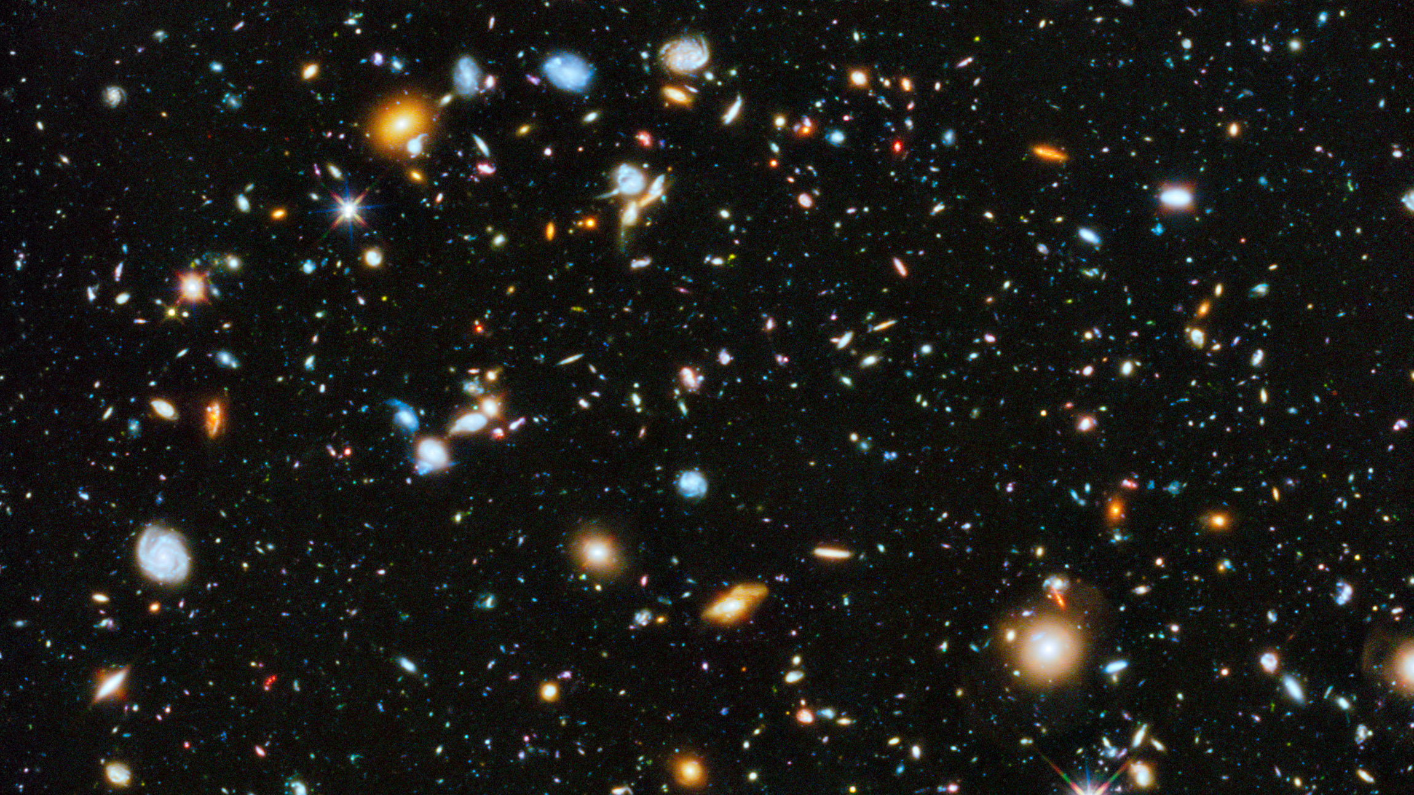
Notes:
https://hubblesite.org/contents/news-releases/2014/news-2014-27.html
Astronomers using the Hubble Space Telescope have assembled a comprehensive picture of the evolving universe – among the most colorful deep space images ever captured by the 24-year-old telescope. This study, which includes ultraviolet light, provides the missing link in star formation.
CREDITS:Image: NASA, ESA, H. Teplitz and M. Rafelski (IPAC/Caltech), A. Koekemoer (STScI), R. Windhorst (Arizona State University), and Z. Levay (STScI); Science: NASA, ESA, H. Teplitz and M. Rafelski (IPAC/Caltech), P. Kurczynski (Rutgers University), N. Bond (Goddard Space Flight Center), E. Soto (Catholic University), N. Grogin and A. Koekemoer (STScI), H. Atek (École Polytechnique Fédérale de Lausanne, Switzerland), T. Brown and D. Coe (STScI), J. Colbert and Y. Dai (IPAC/Caltech), H. Ferguson (STScI), S. Finkelstein (University of Texas, Austin), J. Gardner (Goddard Space Flight Center), E. Gawiser (Rutgers University), M. Giavalisco (University of Massachusetts, Amherst), C. Gronwall (Penn State University), D. Hanish (IPAC/Caltech), K.-S. Lee (Purdue University), Z. Levay (STScI), D. De Mello (Catholic University), S. Ravindranath and R. Ryan (STScI), B. Siana (University of California, Riverside), C. Scarlata (University of Minnesota, Minneapolis), E. Voyer (CNRS, Marseille), and R. Windhorst (Arizona State University)

Slide 2

W2021: A Digital Odyssey
Notes:
https://www.pinterest.ca/pin/231302130841121655/

Slide 3
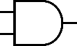
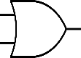
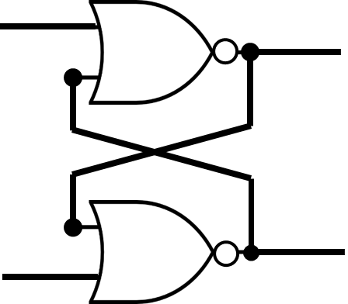
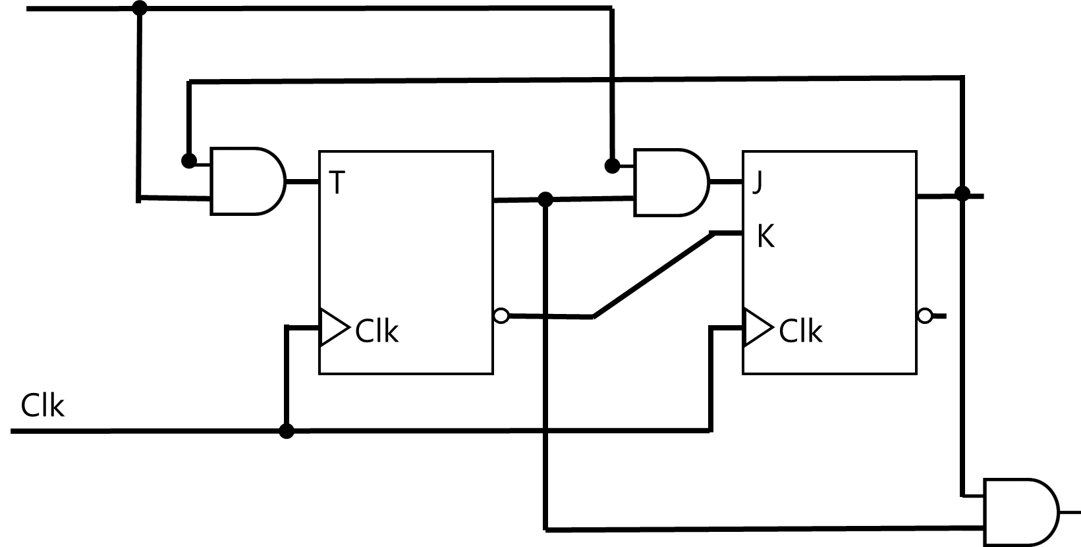
Number Systems |
(12)₁₀ → (1100)₂
Number Systems | Logic Gates |
Number Systems | Logic Gates | Combinational Logic |
Number Systems | Logic Gates | Combinational Logic | Flip-Flops |
Number Systems | Logic Gates | Combinational Logic | Flip-Flops | Sequential Logic |
Number Systems | Logic Gates | Combinational Logic | Flip-Flops| Sequential Logic | Computer Systems

Slide 4
Flip-Flop
A single edge triggered latch

Slide 5
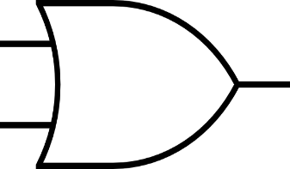
R
D
T
K
S
J
Clk
Clk
Clk
Clk
S | R | Q
0 | 0 | Q_{t}
0 | 1 | 0
1 | 0 | 1
1 | 1 | X
D | Q
0 | 0
1 | 1
T | Q
0 | Q_{t}
1 | Q’_{t}
J | K | Q
0 | 0 | Q_{t}
0 | 1 | 0
1 | 0 | 1
1 | 1 | Q’_{t}

Slide 6
Single Edge
Positive
FF
Clk

Slide 7
Analysis: Given a sequential circuit, show the behavior
vs.
Design: Given a behavior, build the sequential circuit

Slide 8
Only
Flip-Flop
Sequential
Logic
Flip-Flop
+
Inputs
Flip-Flop
+
Inputs
+
Outputs

Slide 9
Analysis (Recap)
0. Is the circuit sequential or combinational? Any FF or feedback → Sequential
1. What are the flip-flops? RS, D, T, JK, or mixed (e.g., 2 JK, 1 RS, …)
2. What are the state combinations? 2^{#FF}
3. Form “State” table:
a) Columns: for each FF, two columns:
one for current state,
one for next state
b) Rows: for each state combination
In total: 2^{#FF}
4. Fill the state table for next state columns based on:
the current state
the inputs to the FFs
5. Form State Transition Diagram
6. (Optional) Analyze paths and states in state transition diagram

Slide 10
Analysis
by an example

Slide 11
R
T
J
S
K
Clk
Clk
Clk
Clk

Slide 12
Analysis
0) Is it sequential circuit?
At least one FF → Yes
At least one feedback → Yes
Otherwise → No

Slide 13
R
T
J
S
K
Clk
Clk
Clk
Clk

Slide 14
Analysis
1) What are the FFs?
1.1. We pick a name for each FF
1.2. We note the type of FF

Slide 15
C
B
A
R
T
J
S
K
Clk
Clk
Clk
Clk

Slide 16
Analysis
2) What are the state combinations (possibilities)?
Each FF can have {0,1} states
In total, 2^{#FFs}

Slide 17
C
B
A
R
T
J
S
K
Clk
Clk
Clk
Clk
#FFs = 3 → 2³ = 8 combinations

Slide 18
Analysis
3) Form a ‘State’ Table
3.1. For each FF, one column for current state
3.2. For each FF, one column for next state
3.3. For each combination of current state one row

Slide 19
C
B
A
R
T
J
S
K
Clk
Clk
Clk
Clk
Q(T) |  |  | Q(T+1)
C | B | A | C | B | A

Slide 20
Analysis
4) Fill the ‘State’ table
For each FF, we determine the next state based on
current state
the current value of inputs to the FF

Slide 21
C
B
A
R
T
J
S
K
Clk
Clk
Clk
Clk
Q(T) |  |  | Q(T+1)
C | B | A | C | B | A
0 | 0 | 0 |  |  | Q_{A}(T)=0 J_{A}=Q’_{B}(T)=1 K_{A}=Q_{B}(T)=0 ---------------- Set Action: 1
0 | 0 | 1
0 | 1 | 0
0 | 1 | 1
1 | 0 | 0
1 | 0 | 1
1 | 1 | 0
1 | 1 | 1

Slide 22
C
B
A
R
T
J
S
K
Clk
Clk
Clk
Clk
Q(T) |  |  | Q(T+1)
C | B | A | C | B | A
0 | 0 | 0 |  | Q_{B}(T)=0 T_{B}=Q’_{C}(T)=1 -------------- Comp. (Q_{B}(T)) = 1 | 1
0 | 0 | 1
0 | 1 | 0
0 | 1 | 1
1 | 0 | 0
1 | 0 | 1
1 | 1 | 0
1 | 1 | 1

Slide 23
C
B
A
R
T
J
S
K
Clk
Clk
Clk
Clk
Q(T) |  |  | Q(T+1)
C | B | A | C | B | A
0 | 0 | 0 | Q_{C}(T)=0 R_{C}=Q_{A}(T)=0 S_{C}=Q_{B}(T)=0 -------------- Store Q_{C}(T) = 0 | 1 | 1
0 | 0 | 1
0 | 1 | 0
0 | 1 | 1
1 | 0 | 0
1 | 0 | 1
1 | 1 | 0
1 | 1 | 1

Slide 24
Analysis
Q_{A}(T) = A, Q’_{A}(T) = A’
For simplicity, the current status of a FF can be assume to be as a binary variable

Slide 25
1
1
1
R_{C}
T_{B}
J_{A}
S_{C}
K_{A}
Clk
Clk
Clk
Clk
Q(T) |  |  | Q(T+1)
C | B | A | C | B | A
0 | 0 | 0 | 0 | 1 | 1
0 | 0 | 1 | 0 | 1 | 1
0 | 1 | 0 | 1 | 0 | 0
0 | 1 | 1 | X | 0 | 0
1 | 0 | 0 | 1 | 0 | 1
1 | 0 | 1 | 0 | 0 | 1
1 | 1 | 0 | 0 | 1 | 0
1 | 1 | 1 | X | 1 | 0

Slide 26
Analysis
5) State Transition Diagram
5.1. for each state combination (each row), a node
5.2. from one state (node) to another state, a directed edge

Slide 27
000
001
010
011
100
101
110
111

Slide 28
Only
Flip-Flop
Sequential
Logic
Flip-Flop
+
Inputs
Flip-Flop
+
Inputs
+
Outputs

Slide 29
Design
by an example

Slide 30
Counter
Count from 0 to N

Slide 31
Design
0. Do we need combinational logic or sequential logic?
Do we need memory?

Slide 32
Counter
Count from 0 to N
0 → 1 → 2 → 3 → … → N-1 → N

Slide 33
Counter
Count from 0 to N
0 → 1 → 2 → 3 → … → N-1 → N
At each step, we have to see at number we are and then move to next number: i → i+1

Slide 34
Counter
Count from 0 to N
We need a storage to store current number.
We need a sequential circuit!

Slide 35
Design
1. How many storage (flip-flops)?
Depends on the storage you need to store the current state in binary system!

Slide 36
Counter
Count from 0 to N
N = 7
1 → 2 → 3 → 4 → 5 → 6 → 7
000 → 001 → 010 → 011 → 100 → 101 → 110 → 111
For each intermediate state, we need 3 bits → 3 flip-flops

Slide 37
Design
2. Form the state (transition) diagram
Same as analysis,
For each state → one node
For each state transition to next state → a directed edge

Slide 38
000
001
010
011
100
101
110
111

Slide 39
000
001
010
011
100
101
110
Loop to the beginning!
111

Slide 40
000
001
010
011
100
101
110
Stuck in 7
Just one time counter!
111

Slide 41
Design
3. Form the state table
Same as analysis, two columns for each flip-flop (storage unit)
One for current state Q(T)
One for next state Q(T+1)

Slide 42
C
B
A
Clk
Clk
Clk
Clk
Q(T) |  |  | Q(T+1)
C | B | A | C | B | A

Slide 43
Design
4. Fill the state table
Unlike analysis, here we already know what is going to be the next state Q(T+1) based on current state Q(T)

Slide 44
C
B
A
Clk
Clk
Clk
Clk
Q(T) |  |  | Q(T+1)
C | B | A | C | B | A
0 | 0 | 0 | 0 | 0 | 1
0 | 0 | 1
0 | 1 | 0
0 | 1 | 1
1 | 0 | 0
1 | 0 | 1
1 | 1 | 0
1 | 1 | 1

Slide 45
C
B
A
Clk
Clk
Clk
Clk
Q(T) |  |  | Q(T+1)
C | B | A | C | B | A
0 | 0 | 0 | 0 | 0 | 1
0 | 0 | 1 | 0 | 1 | 0
0 | 1 | 0
0 | 1 | 1
1 | 0 | 0
1 | 0 | 1
1 | 1 | 0
1 | 1 | 1

Slide 46
C
B
A
Clk
Clk
Clk
Clk
Q(T) |  |  | Q(T+1)
C | B | A | C | B | A
0 | 0 | 0 | 0 | 0 | 1
0 | 0 | 1 | 0 | 1 | 0
0 | 1 | 0 | 0 | 1 | 1
0 | 1 | 1
1 | 0 | 0
1 | 0 | 1
1 | 1 | 0
1 | 1 | 1

Slide 47
C
B
A
Clk
Clk
Clk
Clk
Q(T) |  |  | Q(T+1)
C | B | A | C | B | A
0 | 0 | 0 | 0 | 0 | 1
0 | 0 | 1 | 0 | 1 | 0
0 | 1 | 0 | 0 | 1 | 1
0 | 1 | 1 | 1 | 0 | 0
1 | 0 | 0
1 | 0 | 1
1 | 1 | 0
1 | 1 | 1

Slide 48
C
B
A
Clk
Clk
Clk
Clk
Q(T) |  |  | Q(T+1)
C | B | A | C | B | A
0 | 0 | 0 | 0 | 0 | 1
0 | 0 | 1 | 0 | 1 | 0
0 | 1 | 0 | 0 | 1 | 1
0 | 1 | 1 | 1 | 0 | 0
1 | 0 | 0 | 1 | 0 | 1
1 | 0 | 1
1 | 1 | 0
1 | 1 | 1

Slide 49
C
B
A
Clk
Clk
Clk
Clk
Q(T) |  |  | Q(T+1)
C | B | A | C | B | A
0 | 0 | 0 | 0 | 0 | 1
0 | 0 | 1 | 0 | 1 | 0
0 | 1 | 0 | 0 | 1 | 1
0 | 1 | 1 | 1 | 0 | 0
1 | 0 | 0 | 1 | 0 | 1
1 | 0 | 1 | 1 | 1 | 0
1 | 1 | 0
1 | 1 | 1

Slide 50
C
B
A
Clk
Clk
Clk
Clk
Q(T) |  |  | Q(T+1)
C | B | A | C | B | A
0 | 0 | 0 | 0 | 0 | 1
0 | 0 | 1 | 0 | 1 | 0
0 | 1 | 0 | 0 | 1 | 1
0 | 1 | 1 | 1 | 0 | 0
1 | 0 | 0 | 1 | 0 | 1
1 | 0 | 1 | 1 | 1 | 0
1 | 1 | 0 | 1 | 1 | 1
1 | 1 | 1

Slide 51
C
B
A
Clk
Clk
Clk
Clk
Q(T) |  |  | Q(T+1)
C | B | A | C | B | A
0 | 0 | 0 | 0 | 0 | 1
0 | 0 | 1 | 0 | 1 | 0
0 | 1 | 0 | 0 | 1 | 1
0 | 1 | 1 | 1 | 0 | 0
1 | 0 | 0 | 1 | 0 | 1
1 | 0 | 1 | 1 | 1 | 0
1 | 1 | 0 | 1 | 1 | 1
1 | 1 | 1 | ? | ? | ?

Slide 52
C
B
A
Clk
Clk
Clk
Clk
Q(T) |  |  | Q(T+1)
C | B | A | C | B | A
0 | 0 | 0 | 0 | 0 | 1
0 | 0 | 1 | 0 | 1 | 0
0 | 1 | 0 | 0 | 1 | 1
0 | 1 | 1 | 1 | 0 | 0
1 | 0 | 0 | 1 | 0 | 1
1 | 0 | 1 | 1 | 1 | 0
1 | 1 | 0 | 1 | 1 | 1
1 | 1 | 1 | 0 | 0 | 0
Loop to the beginning!

Slide 53
C
B
A
Clk
Clk
Clk
Clk
Q(T) |  |  | Q(T+1)
C | B | A | C | B | A
0 | 0 | 0 | 0 | 0 | 1
0 | 0 | 1 | 0 | 1 | 0
0 | 1 | 0 | 0 | 1 | 1
0 | 1 | 1 | 1 | 0 | 0
1 | 0 | 0 | 1 | 0 | 1
1 | 0 | 1 | 1 | 1 | 0
1 | 1 | 0 | 1 | 1 | 1
1 | 1 | 1 | 1 | 1 | 1
Stuck in 7
Just one time counter!

Slide 54
C
B
A
Clk
Clk
Clk
Clk
Q(T) |  |  | Q(T+1)
C | B | A | C | B | A
0 | 0 | 0 | 0 | 0 | 1
0 | 0 | 1 | 0 | 1 | 0
0 | 1 | 0 | 0 | 1 | 1
0 | 1 | 1 | 1 | 0 | 0
1 | 0 | 0 | 1 | 0 | 1
1 | 0 | 1 | 1 | 1 | 0
1 | 1 | 0 | 1 | 1 | 1
1 | 1 | 1 | 0 | 0 | 0
Our Design Choice!

Slide 55
Design
5. What type of storage (flip-flop)?
RS, D, T, JK, or Mixed

Slide 56
Design
5. What type of storage (flip-flop)?
RS, D, T, JK, or Mixed
In terms of design, does not matter.
In terms of efficiency, matters!

Slide 57
Counter
Count from 0 to N=7
Let’s select JK, the complete FF.

Slide 58
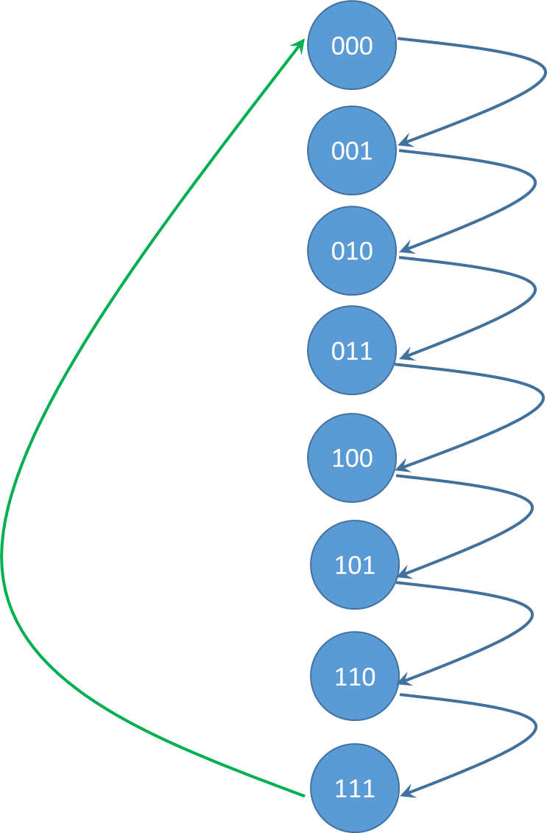
J
J
C
B
A
J
K
K
K
Clk
Clk
Clk
Clk
Q(T) |  |  | Q(T+1)
C | B | A | C | B | A
0 | 0 | 0 | 0 | 0 | 1
0 | 0 | 1 | 0 | 1 | 0
0 | 1 | 0 | 0 | 1 | 1
0 | 1 | 1 | 1 | 0 | 0
1 | 0 | 0 | 1 | 0 | 1
1 | 0 | 1 | 1 | 1 | 0
1 | 1 | 0 | 1 | 1 | 1
1 | 1 | 1 | 0 | 0 | 0

Slide 59
Design
6. Boolean expression for the flip-flops’ input?
input equations, aka, excitation equations

Slide 60
Counter
Count from 0 to N=7
A | J_{A}= | K_{A}=
B | J_{B}= | K_{B}=
C | J_{C}= | K_{C}=

Slide 61
Counter
Count from 0 to N=7
A | J_{A}= | K_{A}=
B | J_{B}= | K_{B}=
C | J_{C}= | K_{C}=

Slide 62
J
J
C
B
A
J
K
K
K
Clk
Clk
Clk
Clk
Q(T) |  |  | Q(T+1)
C | B | A | C | B | A
0 | 0 | 0 | 0 | 0 | 1
0 | 0 | 1 | 0 | 1 | 0
0 | 1 | 0 | 0 | 1 | 1
0 | 1 | 1 | 1 | 0 | 0
1 | 0 | 0 | 1 | 0 | 1
1 | 0 | 1 | 1 | 1 | 0
1 | 1 | 0 | 1 | 1 | 1
1 | 1 | 1 | 0 | 0 | 0

Slide 63
J
J
C
B
A
J
K
K
K
Clk
Clk
Clk
Clk
Q(T) |  |  | Q(T+1) |  |  | Not part of state table!
C | B | A | C | B | A | Action | J_{A} | K_{A}
0 | 0 | 0 | 0 | 0 | 1
0 | 0 | 1 | 0 | 1 | 0
0 | 1 | 0 | 0 | 1 | 1
0 | 1 | 1 | 1 | 0 | 0
1 | 0 | 0 | 1 | 0 | 1
1 | 0 | 1 | 1 | 1 | 0
1 | 1 | 0 | 1 | 1 | 1
1 | 1 | 1 | 0 | 0 | 0

Slide 64
J
J
C
B
A
J
K
K
K
Clk
Clk
Clk
Clk
Q(T) |  |  | Q(T+1) |  |  | Not part of state table!
C | B | A | C | B | A | Action | J_{A} | K_{A}
0 | 0 | 0 | 0 | 0 | 1 | Set | 1 | 0
0 | 0 | 1 | 0 | 1 | 0
0 | 1 | 0 | 0 | 1 | 1
0 | 1 | 1 | 1 | 0 | 0
1 | 0 | 0 | 1 | 0 | 1
1 | 0 | 1 | 1 | 1 | 0
1 | 1 | 0 | 1 | 1 | 1
1 | 1 | 1 | 0 | 0 | 0

Slide 65
OR

Slide 66
J
J
C
B
A
J
K
K
K
Clk
Clk
Clk
Clk
Q(T) |  |  | Q(T+1) |  |  | Not part of state table!
C | B | A | C | B | A | Action | J_{A} | K_{A}
0 | 0 | 0 | 0 | 0 | 1 | Comp | 1 | 1
0 | 0 | 1 | 0 | 1 | 0
0 | 1 | 0 | 0 | 1 | 1
0 | 1 | 1 | 1 | 0 | 0
1 | 0 | 0 | 1 | 0 | 1
1 | 0 | 1 | 1 | 1 | 0
1 | 1 | 0 | 1 | 1 | 1
1 | 1 | 1 | 0 | 0 | 0

Slide 67
J
J
C
B
A
J
K
K
K
Clk
Clk
Clk
Clk
Q(T) |  |  | Q(T+1) |  |  | Not part of state table!
C | B | A | C | B | A | Action | J_{A} | K_{A}
0 | 0 | 0 | 0 | 0 | 1 | Set/Comp | 1 | 0/1 → X
0 | 0 | 1 | 0 | 1 | 0
0 | 1 | 0 | 0 | 1 | 1
0 | 1 | 1 | 1 | 0 | 0
1 | 0 | 0 | 1 | 0 | 1
1 | 0 | 1 | 1 | 1 | 0
1 | 1 | 0 | 1 | 1 | 1
1 | 1 | 1 | 0 | 0 | 0

Slide 68
J
J
C
B
A
J
K
K
K
Clk
Clk
Clk
Clk
Q(T) |  |  | Q(T+1) |  |  | Not part of state table!
C | B | A | C | B | A | Action | J_{A} | K_{A}
0 | 0 | 0 | 0 | 0 | 1 | Set/Comp | 1 | X
0 | 0 | 1 | 0 | 1 | 0 | Reset | 0 | 1
0 | 1 | 0 | 0 | 1 | 1
0 | 1 | 1 | 1 | 0 | 0
1 | 0 | 0 | 1 | 0 | 1
1 | 0 | 1 | 1 | 1 | 0
1 | 1 | 0 | 1 | 1 | 1
1 | 1 | 1 | 0 | 0 | 0

Slide 69
OR

Slide 70
J
J
C
B
A
J
K
K
K
Clk
Clk
Clk
Clk
Q(T) |  |  | Q(T+1) |  |  | Not part of state table!
C | B | A | C | B | A | Action | J_{A} | K_{A}
0 | 0 | 0 | 0 | 0 | 1 | Set/Comp | 1 | X
0 | 0 | 1 | 0 | 1 | 0 | Comp. | 1 | 1
0 | 1 | 0 | 0 | 1 | 1
0 | 1 | 1 | 1 | 0 | 0
1 | 0 | 0 | 1 | 0 | 1
1 | 0 | 1 | 1 | 1 | 0
1 | 1 | 0 | 1 | 1 | 1
1 | 1 | 1 | 0 | 0 | 0

Slide 71
J
J
C
B
A
J
K
K
K
Clk
Clk
Clk
Clk
Q(T) |  |  | Q(T+1) |  |  | Not part of state table!
C | B | A | C | B | A | Action | J_{A} | K_{A}
0 | 0 | 0 | 0 | 0 | 1 | Set/Comp | 1 | X
0 | 0 | 1 | 0 | 1 | 0 | Reset/Comp | X | 1
0 | 1 | 0 | 0 | 1 | 1
0 | 1 | 1 | 1 | 0 | 0
1 | 0 | 0 | 1 | 0 | 1
1 | 0 | 1 | 1 | 1 | 0
1 | 1 | 0 | 1 | 1 | 1
1 | 1 | 1 | 0 | 0 | 0

Slide 72
J
J
C
B
A
J
K
K
K
Clk
Clk
Clk
Clk
Q(T) |  |  | Q(T+1) |  |  | Not part of state table!
C | B | A | C | B | A | Action | J_{A} | K_{A}
0 | 0 | 0 | 0 | 0 | 1 | Set/Comp | 1 | X
0 | 0 | 1 | 0 | 1 | 0 | Reset/Comp | X | 1
0 | 1 | 0 | 0 | 1 | 1 | Set/Comp | 1 | X
0 | 1 | 1 | 1 | 0 | 0
1 | 0 | 0 | 1 | 0 | 1
1 | 0 | 1 | 1 | 1 | 0
1 | 1 | 0 | 1 | 1 | 1
1 | 1 | 1 | 0 | 0 | 0

Slide 73
J
J
C
B
A
J
K
K
K
Clk
Clk
Clk
Clk
Q(T) |  |  | Q(T+1) |  |  | Not part of state table!
C | B | A | C | B | A | Action | J_{A} | K_{A}
0 | 0 | 0 | 0 | 0 | 1 | Set/Comp | 1 | X
0 | 0 | 1 | 0 | 1 | 0 | Reset/Comp | X | 1
0 | 1 | 0 | 0 | 1 | 1 | Set/Comp | 1 | X
0 | 1 | 1 | 1 | 0 | 0 | Reset/Comp | X | 1
1 | 0 | 0 | 1 | 0 | 1
1 | 0 | 1 | 1 | 1 | 0
1 | 1 | 0 | 1 | 1 | 1
1 | 1 | 1 | 0 | 0 | 0

Slide 74
J
J
C
B
A
J
K
K
K
Clk
Clk
Clk
Clk
Q(T) |  |  | Q(T+1) |  |  | Not part of state table!
C | B | A | C | B | A | Action | J_{A} | K_{A}
0 | 0 | 0 | 0 | 0 | 1 | Set/Comp | 1 | X
0 | 0 | 1 | 0 | 1 | 0 | Reset/Comp | X | 1
0 | 1 | 0 | 0 | 1 | 1 | Set/Comp | 1 | X
0 | 1 | 1 | 1 | 0 | 0 | Reset/Comp | X | 1
1 | 0 | 0 | 1 | 0 | 1 | Set/Comp | 1 | X
1 | 0 | 1 | 1 | 1 | 0 | Reset/Comp | X | 1
1 | 1 | 0 | 1 | 1 | 1 | Set/Comp | 1 | X
1 | 1 | 1 | 0 | 0 | 0 | Reset/Comp | X | 1

Slide 75
Counter
Count from 0 to N=7
Flip-Flops
A | J_{A}=F(C,B,A)=∑(0,2,4,6)+d(1,3,5,7) | K_{A}= F(C,B,A)=∑(1,3,5,7)+d(0,2,4,6)
B | J_{B}= | K_{B}=
C | J_{C}= | K_{C}=

Slide 76
Counter
Count from 0 to N=7
A | J_{A}=F(C,B,A)=∑(0,2,4,6)+d(1,3,5,7) | K_{A}= F(C,B,A)=∑(1,3,5,7)+d(0,2,4,6)
B | J_{B}= | K_{B}=
C | J_{C}= | K_{C}=

Slide 77
J
J
C
B
A
J
K
K
K
Clk
Clk
Clk
Clk
Q(T) |  |  | Q(T+1) |  |  | Not part of state table!
C | B | A | C | B | A | Action | J_{B} | K_{B}
0 | 0 | 0 | 0 | 0 | 1 | Store | 0 | 0
0 | 0 | 1 | 0 | 1 | 0
0 | 1 | 0 | 0 | 1 | 1
0 | 1 | 1 | 1 | 0 | 0
1 | 0 | 0 | 1 | 0 | 1
1 | 0 | 1 | 1 | 1 | 0
1 | 1 | 0 | 1 | 1 | 1
1 | 1 | 1 | 0 | 0 | 0

Slide 78
OR

Slide 79
J
J
C
B
A
J
K
K
K
Clk
Clk
Clk
Clk
Q(T) |  |  | Q(T+1) |  |  | Not part of state table!
C | B | A | C | B | A | Action | J_{B} | K_{B}
0 | 0 | 0 | 0 | 0 | 1 | Reset | 0 | 1
0 | 0 | 1 | 0 | 1 | 0
0 | 1 | 0 | 0 | 1 | 1
0 | 1 | 1 | 1 | 0 | 0
1 | 0 | 0 | 1 | 0 | 1
1 | 0 | 1 | 1 | 1 | 0
1 | 1 | 0 | 1 | 1 | 1
1 | 1 | 1 | 0 | 0 | 0

Slide 80
J
J
C
B
A
J
K
K
K
Clk
Clk
Clk
Clk
Q(T) |  |  | Q(T+1) |  |  | Not part of state table!
C | B | A | C | B | A | Action | J_{B} | K_{B}
0 | 0 | 0 | 0 | 0 | 1 | Store/Reset | 0 | X
0 | 0 | 1 | 0 | 1 | 0 | Set/Comp | 1 | X
0 | 1 | 0 | 0 | 1 | 1 | Store/Set | X | 0
0 | 1 | 1 | 1 | 0 | 0 | Reset/Comp | X | 1
1 | 0 | 0 | 1 | 0 | 1 | Store/Reset | 0 | X
1 | 0 | 1 | 1 | 1 | 0 | Set/Comp | 1 | X
1 | 1 | 0 | 1 | 1 | 1 | Store/Set | X | 0
1 | 1 | 1 | 0 | 0 | 0 | Reset/Comp | X | 1

Slide 81
Counter
Count from 0 to N=7
A | J_{A}=F(C,B,A)=∑(0,2,4,6)+d(1,3,5,7) | K_{A}= F(C,B,A)=∑(1,3,5,7)+d(0,2,4,6)
B | J_{B}=F(C,B,A)= ∑(1,5)+d(2,3,6,7) | K_{B}=F(C,B,A)= ∑(3,7)+d(0,1,4,5)
C | J_{C}= | K_{C}=

Slide 82
Counter
Count from 0 to N=7
A | J_{A}=F(C,B,A)=∑(0,2,4,6)+d(1,3,5,7) | K_{A}= F(C,B,A)=∑(1,3,5,7)+d(0,2,4,6)
B | J_{B}=F(C,B,A)= ∑(1,5)+d(2,3,6,7) | K_{B}=F(C,B,A)= ∑(3,7)+d(0,1,4,5)
C | J_{C}= | K_{C}=

Slide 83
J
J
C
B
A
J
K
K
K
Clk
Clk
Clk
Clk
Q(T) |  |  | Q(T+1) |  |  | Not part of state table!
C | B | A | C | B | A | Action | J_{C} | K_{C}
0 | 0 | 0 | 0 | 0 | 1 | Store/Reset | 0 | X
0 | 0 | 1 | 0 | 1 | 0 | Store/Reset | 0 | X
0 | 1 | 0 | 0 | 1 | 1 | Store/Reset | 0 | X
0 | 1 | 1 | 1 | 0 | 0 | Comp/Set | 1 | X
1 | 0 | 0 | 1 | 0 | 1 | Store/Set | X | 0
1 | 0 | 1 | 1 | 1 | 0 | Store/Set | X | 0
1 | 1 | 0 | 1 | 1 | 1 | Store/Set | X | 0
1 | 1 | 1 | 0 | 0 | 0 | Comp/Reset | X | 1

Slide 84
Counter
Count from 0 to N=7
A | J_{A}=F(C,B,A)=∑(0,2,4,6)+d(1,3,5,7) | K_{A}= F(C,B,A)=∑(1,3,5,7)+d(0,2,4,6)
B | J_{B}=F(C,B,A)= ∑(1,5)+d(2,3,6,7) | K_{B}=F(C,B,A)= ∑(3,7)+d(0,1,4,5)
C | J_{C}=F(C,B,A)=∑(3)+d(4,5,6,7) | K_{C}=F(C,B,A)= ∑(7)+d(0,1,2,3)

Slide 85
Design
7. Minimization of input (excitation) equations

Slide 86
Counter
Count from 0 to N=7
3-Variable K-Map
A | J_{A}=F(C,B,A)=∑(0,2,4,6)+d(1,3,5,7) | K_{A}= F(C,B,A)=∑(1,3,5,7)+d(0,2,4,6)
B | J_{B}=F(C,B,A)= ∑(1,5)+d(2,3,6,7) | K_{B}=F(C,B,A)= ∑(3,7)+d(0,1,4,5)
C | J_{C}=F(C,B,A)=∑(3)+d(4,5,6,7) | K_{C}=F(C,B,A)= ∑(7)+d(0,1,2,3)

Slide 87
 |  | BA
 |  | 00 | 01 | 11 | 10
C | 0 | m₀ | m₁ | m₃ | m₂
 | 1 | m₄ | m₅ | m₇ | m₆
 |  | BA
 |  | 00 | 01 | 11 | 10
C | 0 | m₀ | m₁ | m₃ | m₂
 | 1 | m₄ | m₅ | m₇ | m₆
 |  | BA
 |  | 00 | 01 | 11 | 10
C | 0 | m₀ | m₁ | m₃ | m₂
 | 1 | m₄ | m₅ | m₇ | m₆
0 | 0 | 1 | 0
X | X | X | X
0 | 1 | X | X
0 | 1 | X | X
1 | X | X | 1
1 | X | X | 1
J_{C}=F(C,B,A)=∑(3)+d(4,5,6,7)
J_{C}=BA
J_{B}=F(C,B,A)= ∑(1,5)+d(2,3,6,7)
J_{B}=A
J_{A}=F(C,B,A)=∑(0,2,4,6)+d(1,3,5,7)
J_{A}=1
 |  | BA
 |  | 00 | 01 | 11 | 10
C | 0 | m₀ | m₁ | m₃ | m₂
 | 1 | m₄ | m₅ | m₇ | m₆
 |  | BA
 |  | 00 | 01 | 11 | 10
C | 0 | m₀ | m₁ | m₃ | m₂
 | 1 | m₄ | m₅ | m₇ | m₆
 |  | BA
 |  | 00 | 01 | 11 | 10
C | 0 | m₀ | m₁ | m₃ | m₂
 | 1 | m₄ | m₅ | m₇ | m₆
X | X | X | X
0 | 0 | 1 | 0
X | X | 0 | 1
X | X | 0 | 1
X | 1 | 1 | X
X | 1 | 1 | X
K_{C}=F(C,B,A)= ∑(7)+d(0,1,2,3)
K_{C}=BA
K_{B}=F(C,B,A)= ∑(3,7)+d(0,1,4,5)
K_{B}=A’
K_{A}= F(C,B,A)=∑(1,3,5,7)+d(0,2,4,6)
K_{A}=1

Slide 88
Design
8. Draw/Sketch Logic Circuit

Slide 89
BA
J
A
J
1
C
B
A
J
BA
K
A’
K
1
K
Clk
Clk
Clk
Clk

Slide 90
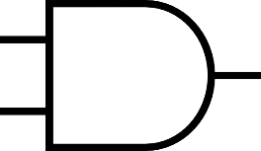
J
J
1
C
B
A
J
K
K
1
K
Clk
Clk
Clk
Clk

Slide 91
Design
9. (Optional) Test

Slide 92
J
J
1
1
0
1
J
K
K
1
K
Clk
Clk
Clk
Clk
Q(T) |  |  | Q(T+1)
C | B | A | C | B | A
1 | 0 | 1 | ? | ? | ?
5 → ?

Slide 93
J
J
1
1
0
1
J
K
K
1
K
Clk
Clk
Clk
Clk
Q(T) |  |  | Q(T+1)
C | B | A | C | B | A
1 | 0 | 1 | ? | ? | ?
5 → ?

Slide 94
J
J
1
1
0
1
J
K
K
1
K
Clk
Clk
Clk
Clk
Q(T) |  |  | Q(T+1)
C | B | A | C | B | A
1 | 0 | 1 | ? | ? | A=1, J_{A}=1, K_{A}=1 ---------- Comp. → 0
5 → ?

Slide 95
J
J
1
1
0
1
J
K
K
1
K
Clk
Clk
Clk
Clk
Q(T) |  |  | Q(T+1)
C | B | A | C | B | A
1 | 0 | 1 | ? | ? | 0
5 → ?

Slide 96
J
J
1
1
0
1
J
K
K
1
K
Clk
Clk
Clk
Clk
Q(T) |  |  | Q(T+1)
C | B | A | C | B | A
1 | 0 | 1 | ? | B=0, J_{B}=A=1, K_{B}=A’=0 --------- Set → 1 | 0
5 → ?

Slide 97
J
J
1
1
0
1
J
K
K
1
K
Clk
Clk
Clk
Clk
Q(T) |  |  | Q(T+1)
C | B | A | C | B | A
1 | 0 | 1 | ? | 1 | 0
5 → ?

Slide 98
J
J
1
1
0
1
J
K
K
1
K
Clk
Clk
Clk
Clk
Q(T) |  |  | Q(T+1)
C | B | A | C | B | A
1 | 0 | 1 | ? | 1 | 0
5 → ?

Slide 99
J
J
1
1
0
1
J
K
K
1
K
Clk
Clk
Clk
Clk
Q(T) |  |  | Q(T+1)
C | B | A | C | B | A
1 | 0 | 1 | C=1, J_{C}=BA=01=0 K_{C}=BA=01=0 --------------- Store → 1 | 1 | 0
5 → ?

Slide 100
J
J
1
1
0
1
J
K
K
1
K
Clk
Clk
Clk
Clk
Q(T) |  |  | Q(T+1)
C | B | A | C | B | A
1 | 0 | 1 | 1 | 1 | 0
5 → 6

Slide 101
Design (Recap)
0. Do we need combinational logic or sequential logic? Do we need memory?
1. How many storage (flip-flops)? #FF
2. Form the state (transition) diagram
3. Form the state table
4. Fill the state table
5. What type of storage (flip-flop)? RS, D, T, JK, or Mixed
6. Input (excitation) equations for each FF
7. Minimization of input (excitation) equations
8. Draw/Sketch Logic Circuit
9. (Optional) Test

Slide 102
Design (Recap)
0. Do we need combinational logic or sequential logic? Do we need memory?
1. How many storage (flip-flops)? #FF
2. Form the state (transition) diagram
3. Form the state table
4. Fill the state table
5. What type of storage (flip-flop)? RS, D, T, JK, or Mixed
6. Input (excitation) equations for each FF
7. Minimization of input (excitation) equations
8. Draw/Sketch Logic Circuit
9. (Optional) Test

Slide 103
Design (Advanced)
0. Do we need combinational logic or sequential logic? Do we need memory?
1. How many storage (flip-flops)? #FF
2. Form the state (transition) diagram
2.1. State Reduction
3. Form the state table
4. Fill the state table
5. What type of storage (flip-flop)? RS, D, T, JK, or Mixed
6. Input (excitation) equations for each FF
7. Minimization of input (excitation) equations
8. Draw/Sketch Logic Circuit
9. (Optional) Test
Theory of Automata
COMP-2140: Computer Languages, Grammars, and Translators

Slide 104
Only
Flip-Flop
Sequential
Logic
Flip-Flop
+
Inputs
Flip-Flop
+
Inputs
+
Outputs

